Slide 1


Slide 2
Introduction
object-oriented programming language developed by Sun Microsystems in 1995
Known for its Write Once, Run Anywhere capability.
used for building desktop applications, web applications, Android apps, and enterprise systems.

Slide 3
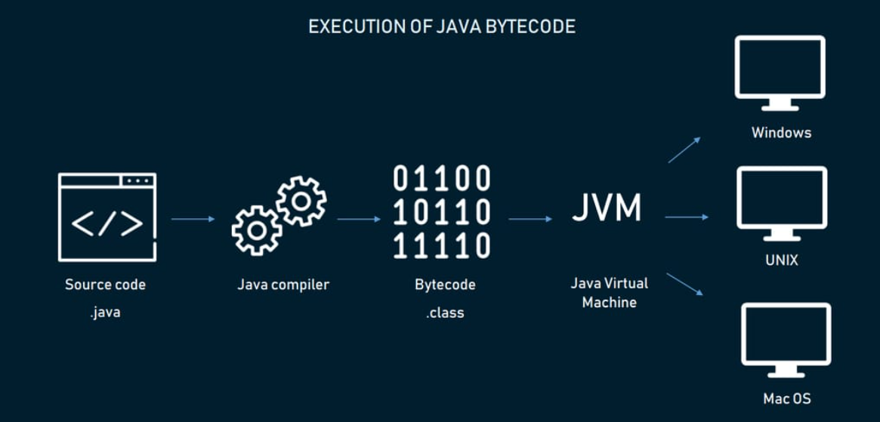
How Java works

Slide 4
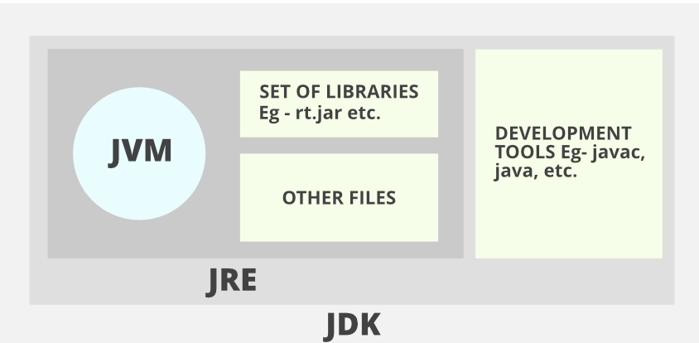
JDK, JRE & JVM

Slide 5
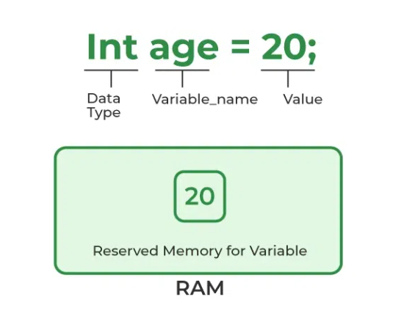
Variables in Java
containers that store data in memory
Java is statically typed language – variables are named with the type of data
Types of Variables - Local, Instance and Static variables

Slide 6
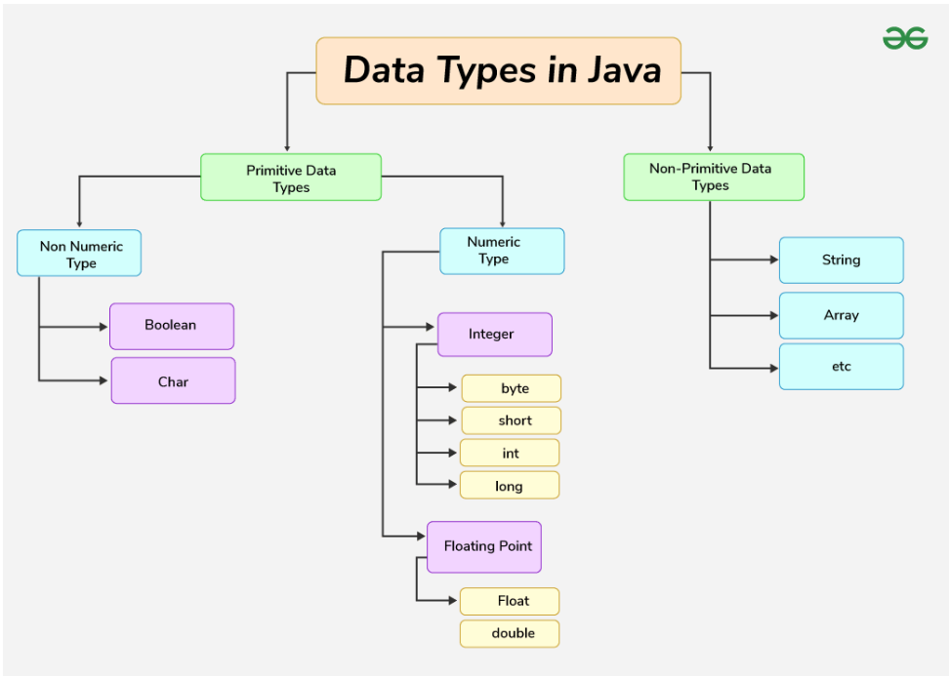
Java Data Types

Slide 7
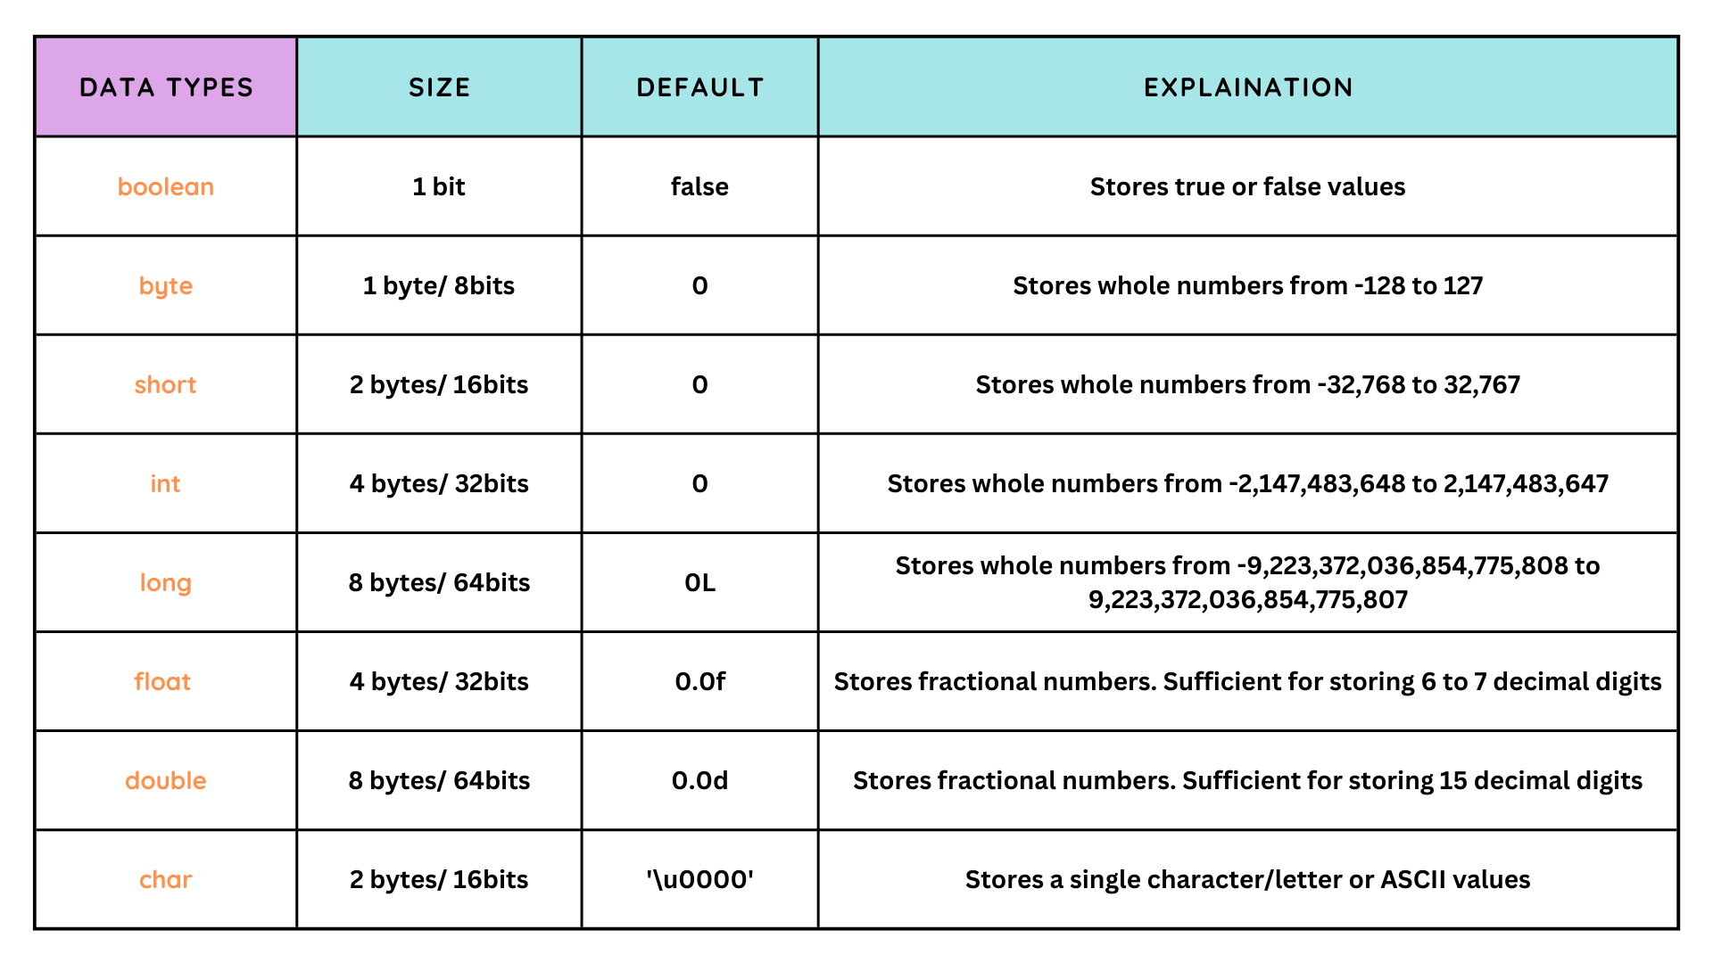

Slide 8
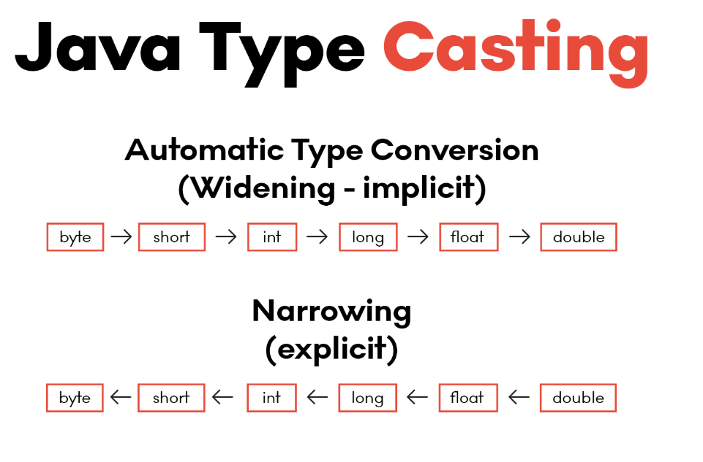
Type Casting in Java

Slide 9

Java Expressions
a combination of variables, constants, operators, and method calls that evaluates to a single value
Expressions are the building blocks of Java programs
Components of an Expression:
Operands - values or variables (e.g., 5, x)
Operators - symbols that perform operations (e.g., +, -, *)
Result - the evaluated value of the expression
Example:
int a = 10; // simple assignment
a += 5; // compound assignment

Slide 10
Operators in Java
Category | Operator | Description | Example | Output
Arithmetic | + | Addition | 5 + 3 | 8
 | - | Subtraction | 5-3 | 2
 | * | Multiplication | 5 * 3 | 15
 | / | Division | 10/2 | 5
 | % | Modulus (remainder) | 10 % 3 | 1
Relational | == | Equal to | 5 == 5 | TRUE
 | != | Not equal to | 5 != 3 | TRUE
 | > | Greater than | 5 > 3 | TRUE
 |  | Less than | 5 < 3 | FALSE
 | >= | Greater or equal | 5 >= 5 | TRUE
 |  | Less or equal | 3 <= 5 | TRUE
Logical | && | Logical AND | (5 > 3 && 2 < 4) | TRUE
 | | | Logical OR | (5 > 3 | 2 < 4) | TRUE
 | ! | Logical NOT | !(5 > 3) | FALSE
Bitwise | & | Bitwise AND |  | 1
 | ` | Bitwise OR | 5 & 3 (0101 & 0011) | 7
 | ^ | Bitwise XOR | 5 ^ 3 | 6
 | ~ | Bitwise Complement | ~5 | -6
 |  | Left shift | 5 << 1 | 10
 | >> | Right shift | 5 >> 1 | 2
 | >>> | Unsigned right shift | -5 >>> 1 | Large positive value
Assignment | = | Assign value | int a = 5; | a = 5
 | += | Add and assign | a += 3; | a = 8
 | -= | Subtract and assign | a -= 2; | a = 6
 | *= | Multiply and assign | a *= 2; | a = 12
 | /= | Divide and assign | a /= 3; | a = 4
 | %= | Modulus and assign | a %= 3; | a = 1
Unary | ++ | Increment | ++a (if a=5) | 6
 | -- | Decrement | --a (if a=5) | 4
 | + | Unary plus | +a | same value
 | - | Unary minus | -a (if a=5) | -5
Miscellaneous | ?: | Ternary operator | (a > b) ? a : b | Larger of a or b
 | instanceof | Type comparison | "Hello" instanceof String | TRUE

Slide 11

Conditional Statements in Java
Allow programs to make decisions based on conditions
Controls the flow of execution depending on whether a condition is true or false
Common types: if, if-else, if-else-if, switch

Slide 12
Conditional Statements – if statement
Syntax:
if (condition) {
// code to execute
}
Example:
int age = 20;
if (age >= 18) {
System.out.println("Eligible to vote");
}

Slide 13
Conditional Statements – if – else statement
Syntax:
if (condition) {
// true block
} else {
// false block
}
Example:
int num = 5;
if (num % 2 == 0) {
System.out.println("Even");
} else {
System.out.println("Odd");
}

Slide 14
Conditional Statements – if – else ladder
Syntax:
if (condition1) {
// block 1
} else if (condition2) {
// block 2
} else {
// default block
}
Example:
int marks = 85;
if (marks >= 90) {
System.out.println("Grade A");
} else if (marks >= 75) {
System.out.println("Grade B");
} else {
System.out.println("Grade C");
}

Slide 15
Conditional Statements - switch statement
Used when a variable is compared against multiple values.
Example:
int day = 3;
switch (day) {
case 1: System.out.println("Monday"); break;
case 2: System.out.println("Tuesday"); break;
case 3: System.out.println("Wednesday"); break;
default: System.out.println("Other day");
}

Slide 16
Looping statements in Java
Allows executing a block of code multiple times
reduce redundancy and make programs efficient
Types of loops in Java:
for loop
while loop
do-while loop
Enhanced for loop (for-each)

Slide 17
Looping Statements – For Loop
Used when the number of iterations is known
Syntax:
for(initialization; condition; update) {
// code block
}
Example:
for(int i = 1; i <= 5; i++) {
System.out.println(i);
}

Slide 18
Looping Statements – while Loop
Used when the number of iterations is not known in advance
Syntax:
while(condition) {
// code block
}
Example:
int i = 1;
while(i <= 5) {
System.out.println(i);
i++;
}

Slide 19
Looping Statements – do- while Loop
Similar to while loop, but executes at least once
Syntax:
do {
// code block
} while(condition);
Example:
int i = 1;
do {
System.out.println(i);
i++;
} while(i <= 5);

Slide 20
Looping Statements – Enhanced For Loop
Simplifies iteration over arrays and collections
Syntax:
for(type variable : array) {
// code block
}
Example:
int[] numbers = {1, 2, 3, 4, 5};
for(int num : numbers) {
System.out.println(num);
}

Slide 21

Controlling Loop Execution - Break and Continue
Java provides special control statements to alter the normal flow of loops
break - Terminates the loop immediately
continue - Skips the current iteration and moves to the next
Useful for handling special cases inside loops

Slide 22

Break statement:
for(int i = 1; i <= 5; i++) {
if(i == 3) {
break; // exits loop when i = 3
}
System.out.println(i);
}
Continue statement:
for(int i = 1; i <= 5; i++) {
if(i == 3) {
continue; // skips printing when i = 3
}
System.out.println(i);
}

Slide 23
Object Oriented Programming Principles
Encapsulation
Inheritance
Polymorphism
Abstraction
Classes
Objects

Slide 24
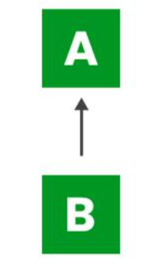
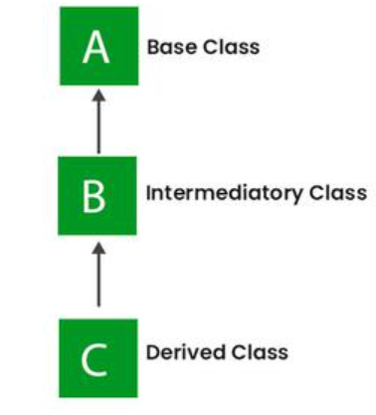
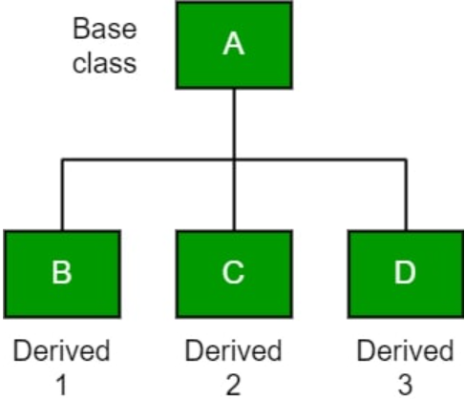
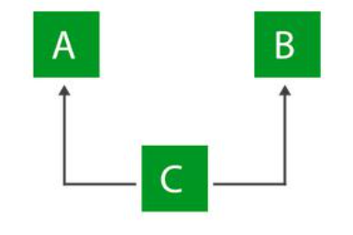
Inheritance
1. Single Inheritance
2. Multilevel Inheritance
3. Hierarchical Inheritance
4. Multiple Inheritance (Through Interfaces)
5. Hybrid Inheritance (Through Interfaces)

Slide 25
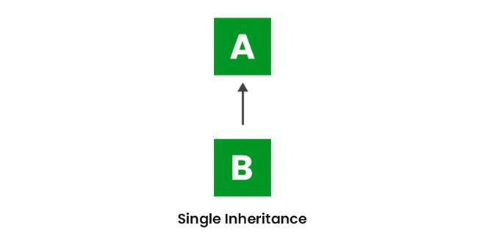
Single Inheritance
A class inherits properties and behaviors from only one superclass.

Slide 26
Multi Level Inheritance
A Chain of Inheritance – Child class being the base class to another

Slide 27
Hierarchical Inheritance
Multiple Subclasses inherit from a single base class

Slide 28
Super Keyword
Reference variable that points to parent class objects
Access Parent class members
Calling parent class constructor
Invoking parent class methods

Slide 29
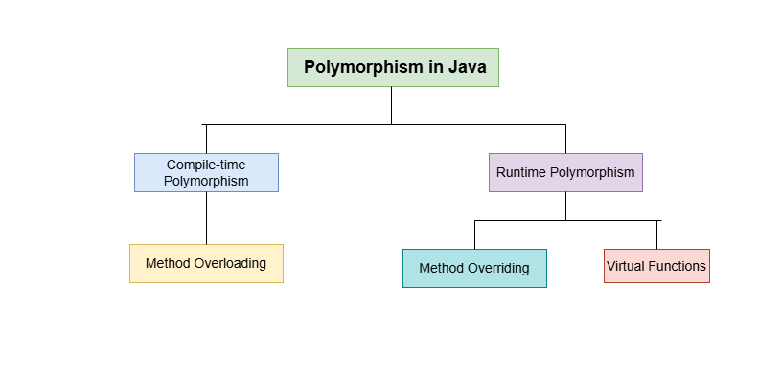
Polymorphism
One thing can take many forms

Slide 30
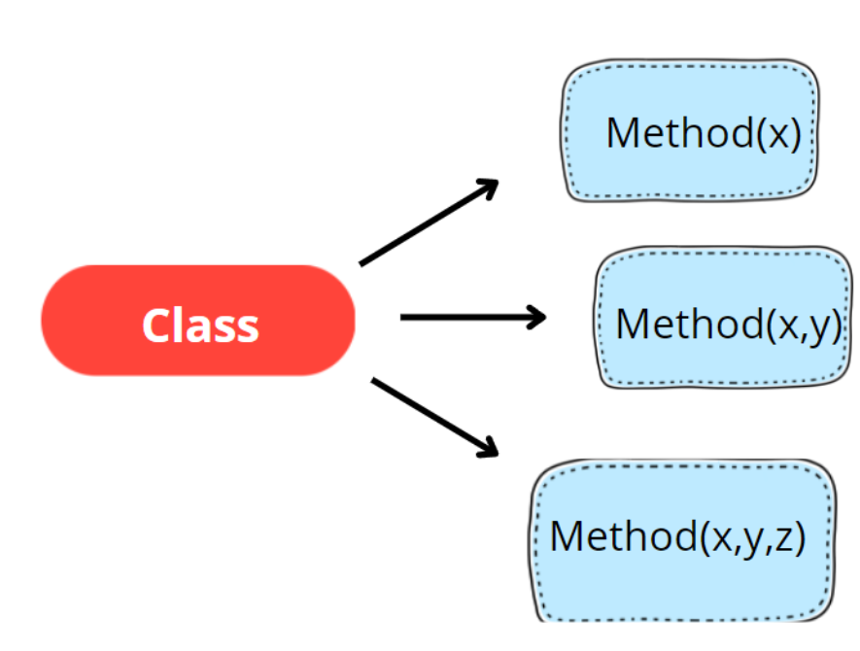
Compile Time Polymorphism - Overloading
allows multiple methods in the same class to have the same name but different parameters
method that gets called is determined at compile time
Implemented in methods and constructors

Slide 31
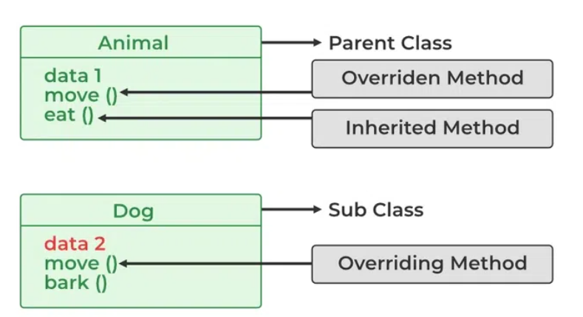
Runtime Polymorphism - Overriding
Allows a subclass to provide implementation of a method that is already defined in parent class
method to be called is determined at runtime based on the actual object type
Implemented using @Override annotation

Slide 32
Abstraction – Abstract Classes and Methods
hides implementation details and only exposes essential functionalities to the end user
Implemented in classes and methods using abstract keyword
Cannot be instantiated – objects cannot be created from parent class
Can be used to create blueprints for child classes

Slide 33

Interfaces
Full abstraction – only define behaviour but no implementations
Supports Multiple Inheritance
Variables are Final and static in nature
Methods are abstract and only implemented in another class

Slide 34
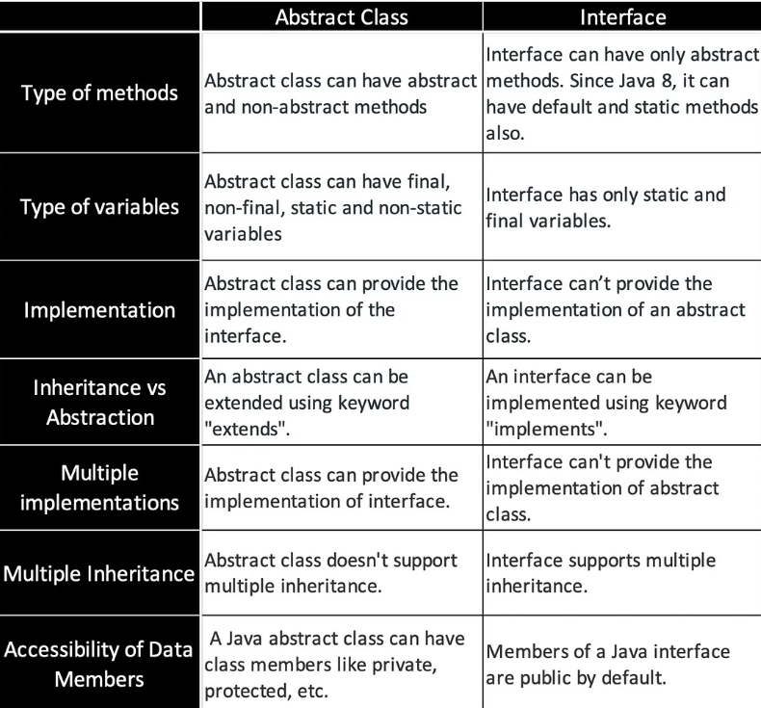

Slide 35
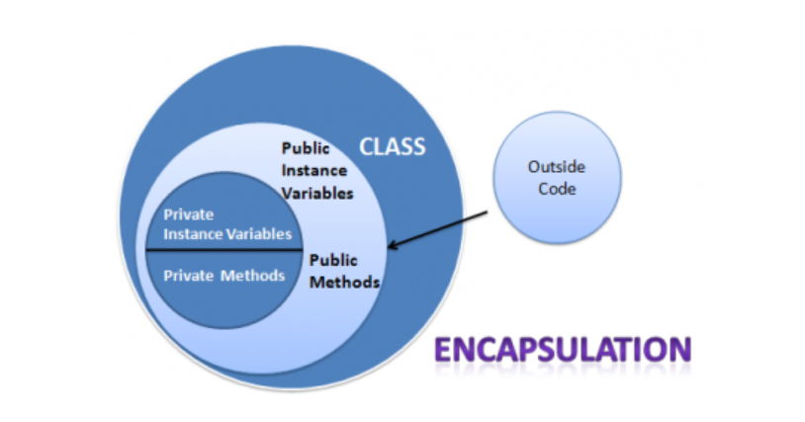
Encapsulation
Data hiding - wrapping the data and corresponding code together as a single unit
Restricts direct access to data and ensures data security
Implemented using:
Access Modifiers -Private, Public, Protected, default

Slide 36
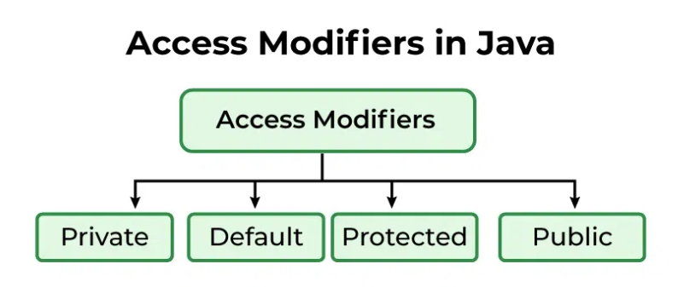
Access Modifiers
Private Access Modifier:
Specified using the keyword private.
The methods or data members are accessible only within the class in which they are declared.
Protected Access Modifier:
Specified using the keyword protected.
The methods or data members are accessible within the same package or subclasses in different packages.
Default Access Modifier:
When no access modifier is specified for a class, method it is said to be having the default access modifier by default.
The default access modifiers are accessible only within the same package
Public Access Modifier:
Specified using the keyword public.
The public access modifier has the widest scope among all other access modifiers.
Classes, methods, or data members are accessible from everywhere in the program. There is no restriction.

Slide 37
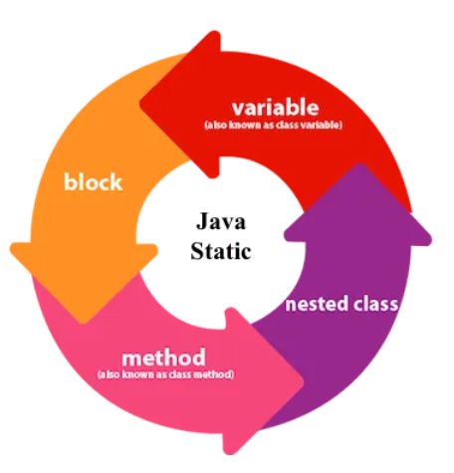
Static keyword
Declared entities(variables, methods, code blocks) belong to the class rather than the instance of the classes
Can be accessed without creating an object of the class
Shared across all instances, reducing memory usage
Variables – belongs to the class, not the instances
Methods – can be accessed without a class object
Code block - executed once when the class is loaded

Slide 38
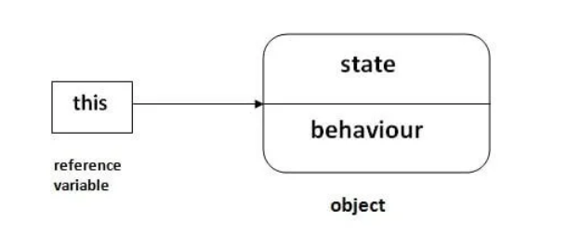
this keyword
Refers to the current instance of the class
Used to differentiate between instance and local variables, constructors and methods

Slide 39
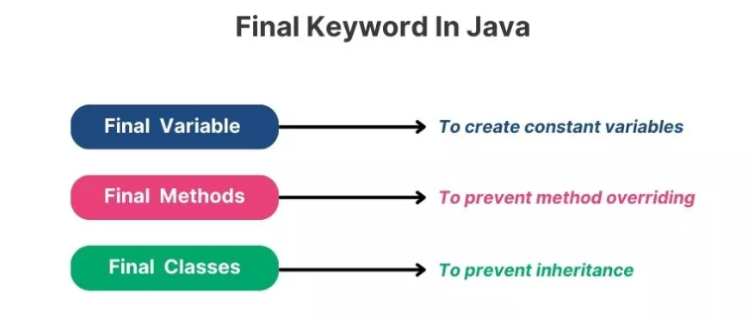
final Keyword
used to declare constants
Avoid overriding and inheritance
Used on variables, classes and methods

Slide 40
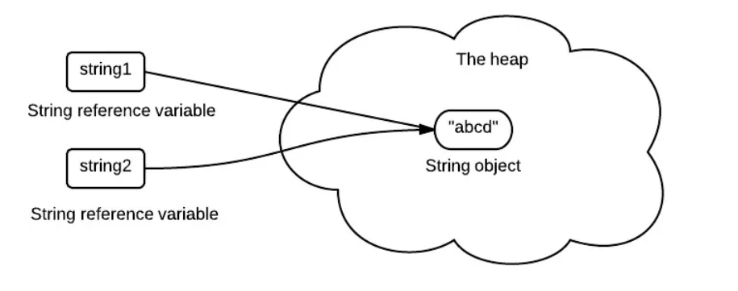
Strings
immutable sequence of characters
Cannot be modified once created –any modification creates a new object instead of altering the original

Slide 41

Strings Examples
Declaration:
datatype variable = “string value”;
Ex: String s = “Welcome”;
String num = “1234”;
String Methods:
1. Converting to lower case
Ex: String s = “Welcome”;
s.toLowerCase();
2. Converting to lower case
Ex: String s = “Welcome”;
s.toUpperCase();
3. Finding a character
Ex: String s = “Welcome”;
s.indexOf(‘c’);
(or)
s.charAt(3);
Indexing:
Indexing will start from 0
W e l c o m e
0 1 2 3 4 5 6
String length:
Syntax:
string name.length();
Ex: String s= “Welcome”;
s.length();

Slide 42
Strings Examples
Concatenation (+) or .concat
String fiName = “Hello";
String laName = “John";
System.out.println(fiName + " " + laName);
(or)
System.out.println(fiName.concat(laName));
Contains()—Returns Boolean value
String fiName = “Hello";
System.out.println(fiName.Contains(“H”);
--This is case sensitive--
Trim()—Removes space in right and left side
String S = “ Hello ";
System.out.println(S.trim();
Escape Sequence:
1. Quote within double quote
// results in error
String txt = "We are the so-called "Vikings“”;
String txt = "We are the so-called \"Vikings\“”;
String txt = "It\'s alright.";
2. \n → New Line
3. \t → Tab

Slide 43
Strings Examples
equals()—Case Sensitive
equalsIgnoreCase()—Not Case Sensitive
String fiName = “Hello";
String laName = “John";
System.out.println(fiName == laName);
(or)
System.out.println(fiName.equals(laName));
replace()—Replace single/multiple (sequence) of character in string
String S = "Welcome to java Selenium”;
System.out.println(S.replace(‘W’, ‘X’));

Slide 44
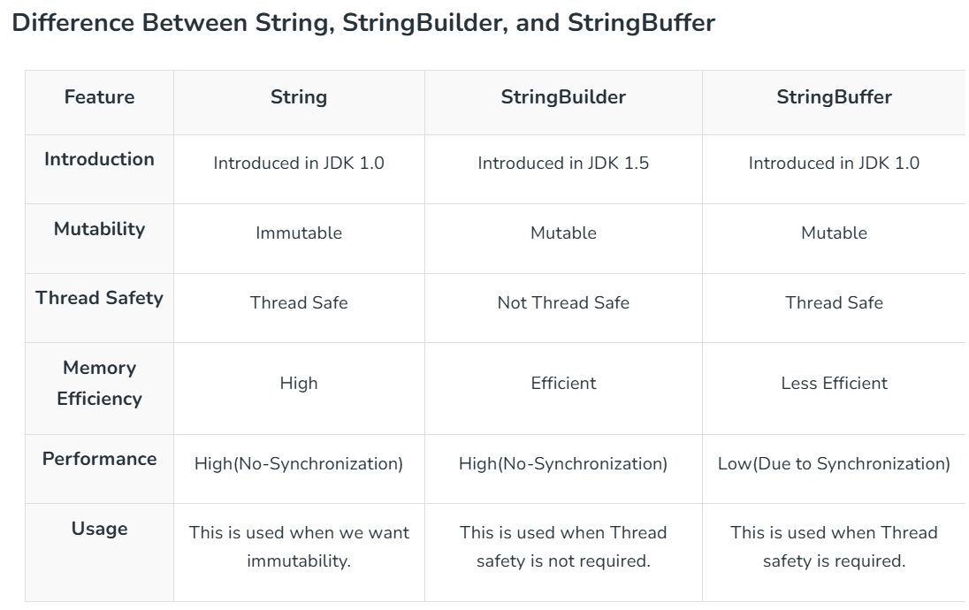
String Builder & String Buffer
classes used to create mutable (modifiable) strings
allows string modifications without creating new objects, making them more memory-efficient

Slide 45
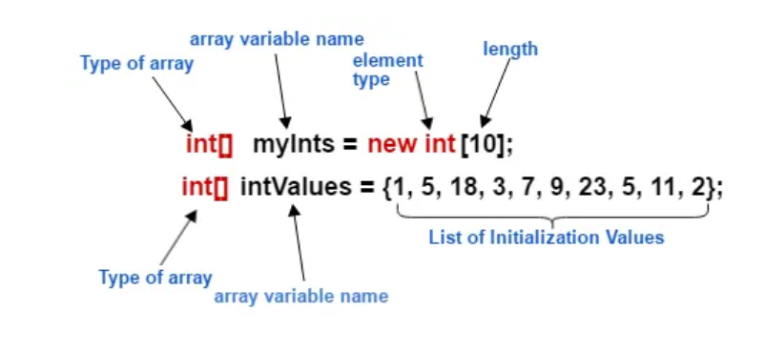
Arrays
Stores multiple elements of the same type in a contiguous memory location
Fixed size, stored in heap memory

Slide 46
Arrays (contd.)
One-Dimensional Arrays:
Definition: Linear collection of elements of the same data type.
Declaration and Initialization: int[] myArray = new int[size]; or int[] myArray = {1, 2, 3};
Accessing elements: myArray[index]
Length: myArray.length
Multi-Dimensional Arrays:
Definition: Arrays of arrays (e.g., 2D matrices).
Declaration and Initialization:
int[][] my2DArray = new int[rows][cols]; or int[][] my2DArray = {{1, 2}, {3, 4}};
Accessing elements: my2DArray[row][col]
Rows: my2DArray.length,
Columns: my2DArray[0].length (assuming consistent column length).
Array Traversal:
Iterating through array elements.
Using for loops (index-based) or enhanced for loops (element-based).
Nested loops for multi-dimensional arrays.

Slide 47
Exceptions -Try Catch Finally
Mechanism to handle exceptions
Application continue to run even if an error occurs
Code in Try Block is executed and if an exception occurs its caught in catch block
We can have multiple catch blocks for a single try block
Finally is used – when we want a line/block of code to execute even if an exception occurs

Slide 48
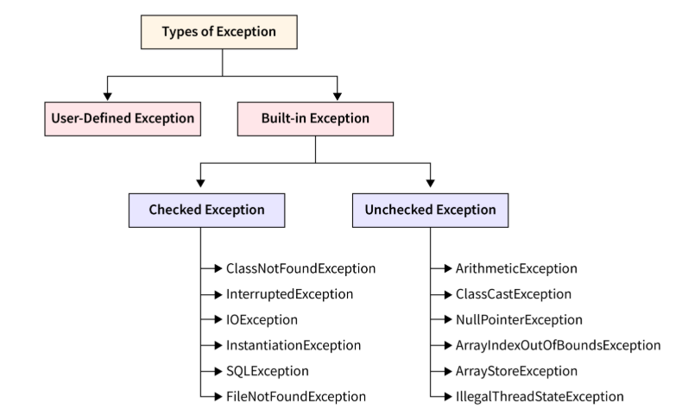
Types of Exceptions

Slide 49
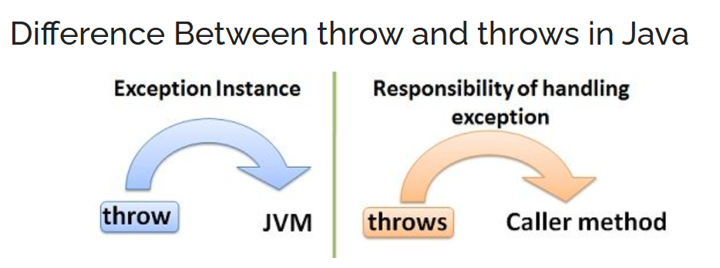
throw and throws keyword
throw - explicitly throw exceptions inside a method or block
Only throws one exception
Used to throw custom exceptions
throws - declare exceptions that a method might throw - tells the compiler that the method may cause an exception, but does not handle it directly
declared in the signature of a method
Can stack multiple exceptions with commas

Slide 50
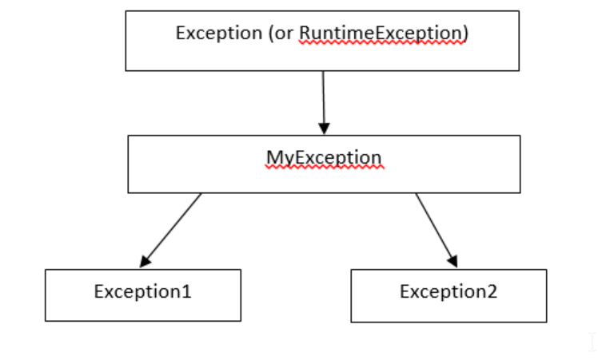
Custom Exceptions
user-defined exception that extends the built-in Exception class
allows to handle domain-specific errors more effectively by creating meaningful error messages
Can be created by extending Exception or RuntimeException class

Slide 51

Collections
provides a set of classes and interfaces to store, manipulate, and process groups of objects efficiently
Consists of the Collections interface and the Collections framework

Slide 52
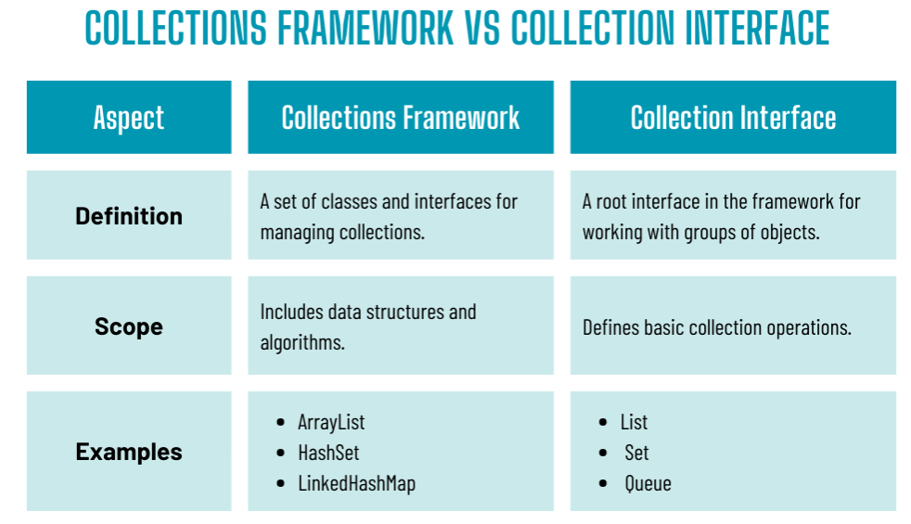

Slide 53
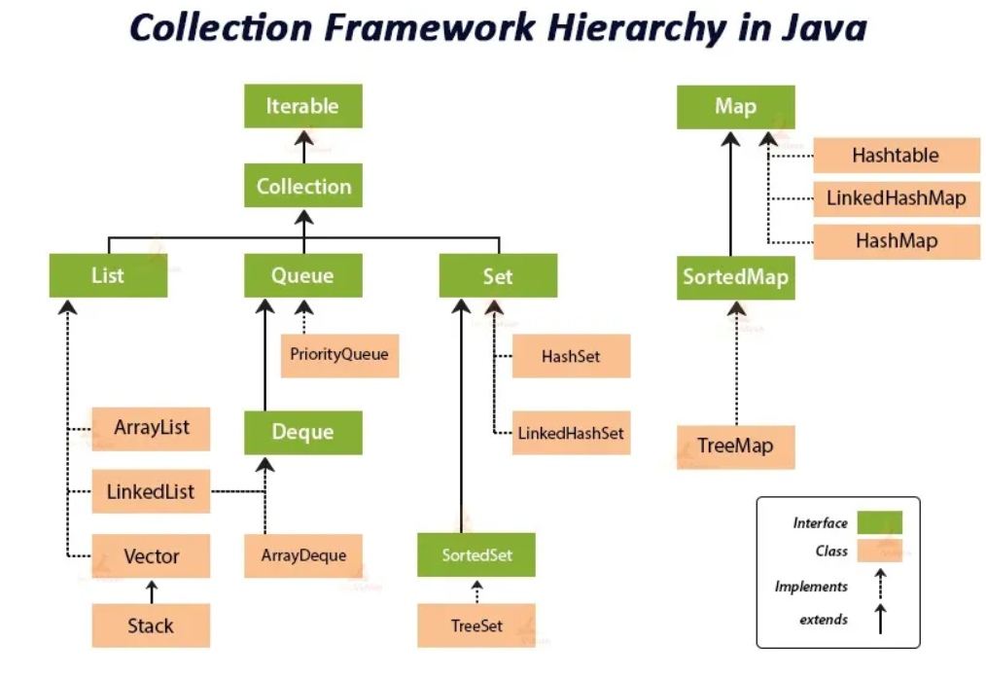
Collections Framework in Java

Slide 54
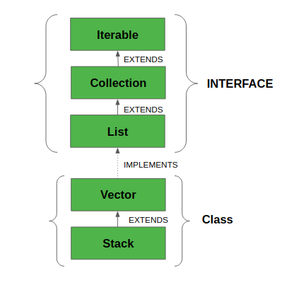
List
ordered collection that allows duplicates
Maintains Insertion Order → Elements are stored in the order they are inserted.
Supports index-based search
Elements can be easily inserted irrespective of position

Slide 55
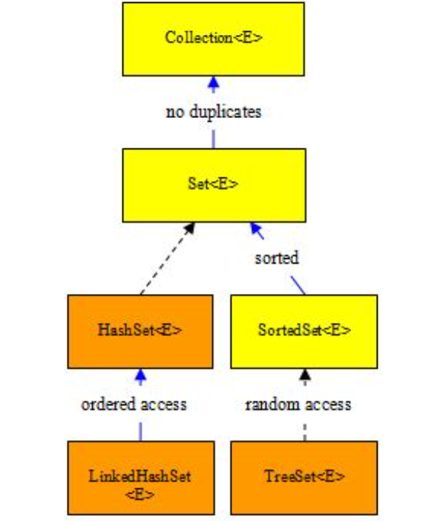
Set
a collection that does not allow duplicate elements
Allows null Values → But only one null element
Index-based search not supported
Not all implementation allows insertion order

Slide 56
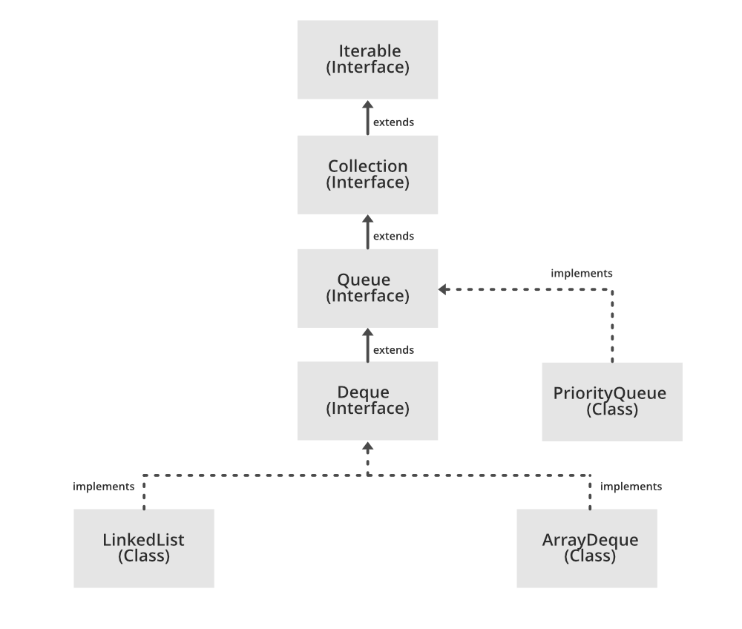
Queue
collection that follows the FIFO (First-In-First-Out)
Elements are added at the rear and removed from the front
Ideal for handling tasks, requests, and scheduling operations

Slide 57
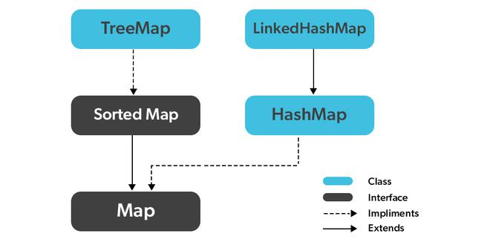
Map
Collection that stores data in key-value pairs
each key is unique, while values can be duplicated
Does not implement collection interface

Slide 58
List- ArrayList
Dynamic Arrays
Size of an Arraylist is increased and decreased automatically
Non-Synchronous
ArrayList Methods
add(index, element): Insert at position.
add(element): Append at end.
get(index): Retrieve element.
set(index, element): Replace element.
remove(index): Remove at index.
indexOf(element): First index.
lastIndexOf(element): Last index.
subList(from, to): Portion of list.

Slide 59
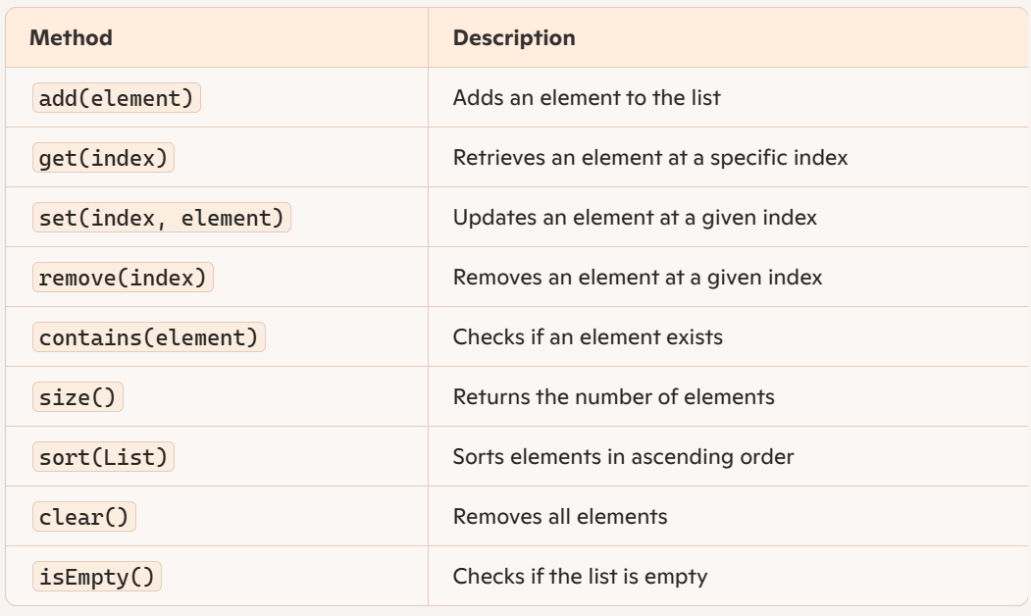
ArrayList methods

Slide 60
ArrayList Usage
When to use: Use ArrayList when fast random access (get(index)) is required.
Why: ArrayList stores elements in contiguous memory, making get(index) O(1) (constant time)
When to avoid: insert or remove elements in the middle, as shifting occurs (O(n))

Slide 61
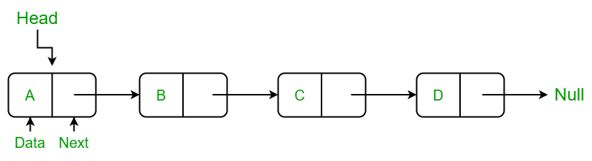
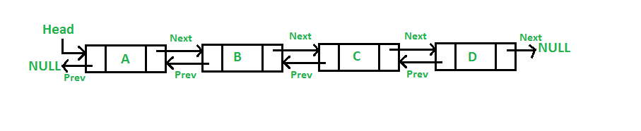
List - Linked List
Implementation of Doubly linked list data structure
Implements List and Deque Interfaces
Maintains the insertion order
Non synchronized
Does not support accessing elements randomly

Slide 62
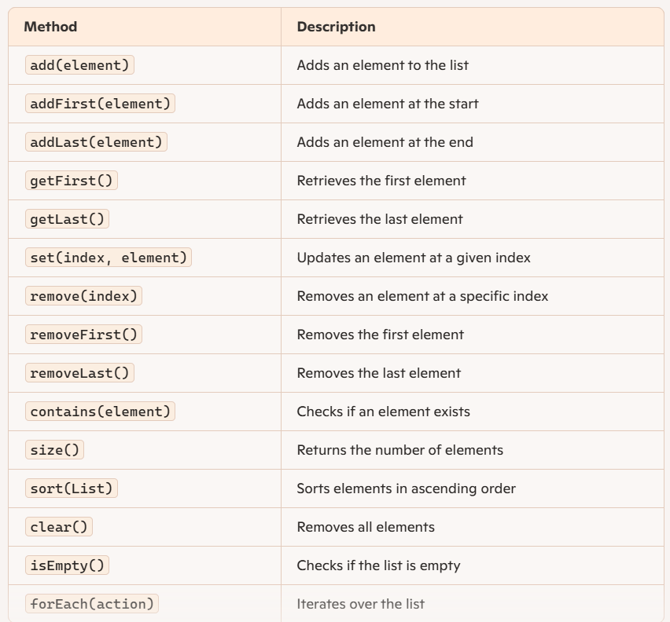
LinkedList methods

Slide 63
LinkedList Usage
When to use: Frequent insertions & deletions (addFirst(), removeLast()).
Why: Uses a doubly linked list, making add/remove operations O(1) (constant time))
When to avoid: When you need random access (get(index) is O(n)).

Slide 64
List - Vector
Growable array of Objects
Synchronized – Thread Safe
Maintains the insertion order
Increases its size by doubling

Slide 65
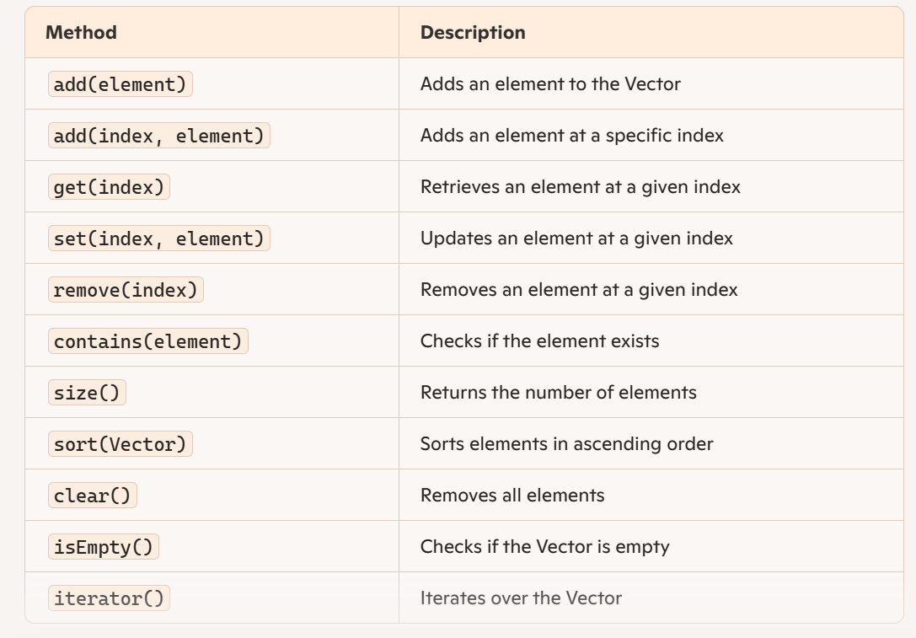
Vector methods

Slide 66
Vector Usage
When to use: Multi-threaded applications requiring synchronization.
Why: Vector is synchronized, meaning multiple threads can safely modify it.
When to avoid: If you don't need thread safety (use ArrayList, it's faster).

Slide 67
List - Stack
Class that works on the basic principle of last-in-first-out
Inherits from Vector class
Thread safe class
Push and Pop Operations

Slide 68
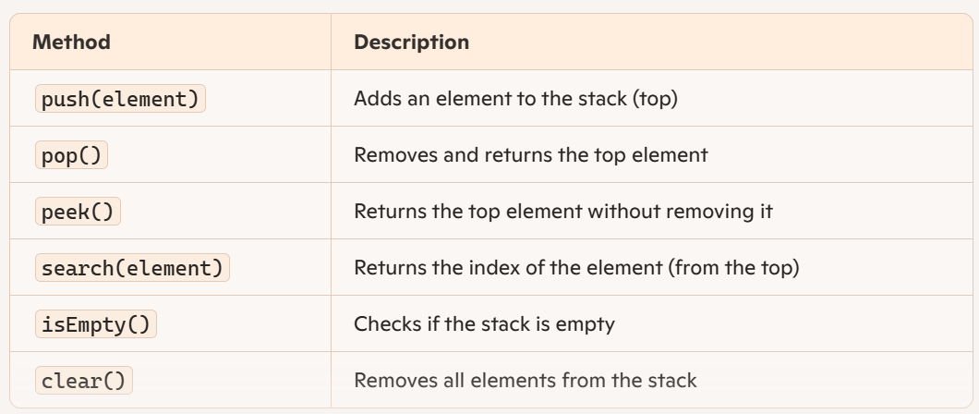
Stack Methods

Slide 69
Stack Usage
When to use: Use cases involving undo/redo functionalities
Undo/Redo Functionality → Used in applications like word processors, Photoshop, and IDEs to track previous actions.
Expression Evaluation → Handles mathematical calculations ((a + b) * c) and postfix notation.
Browser History → Tracks visited pages, allowing users to go back to the last viewed page (Ctrl + Z functionality).
When to avoid : Wherever you can use a List class

Slide 70
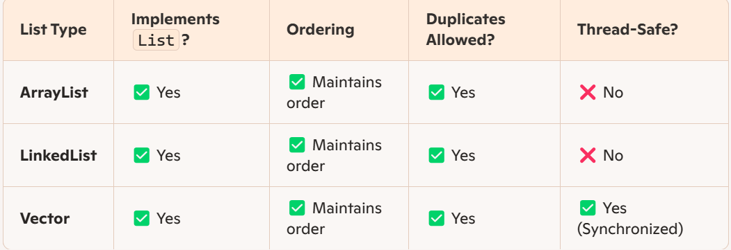
Comparing the List Classes

Slide 71
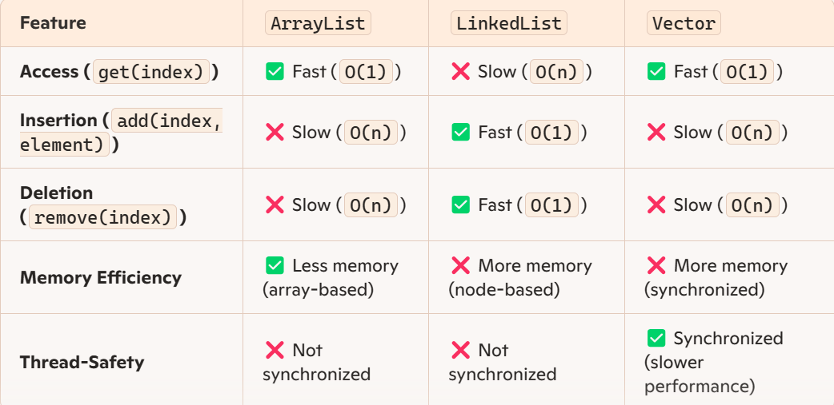
Comparing the List Classes

Slide 72
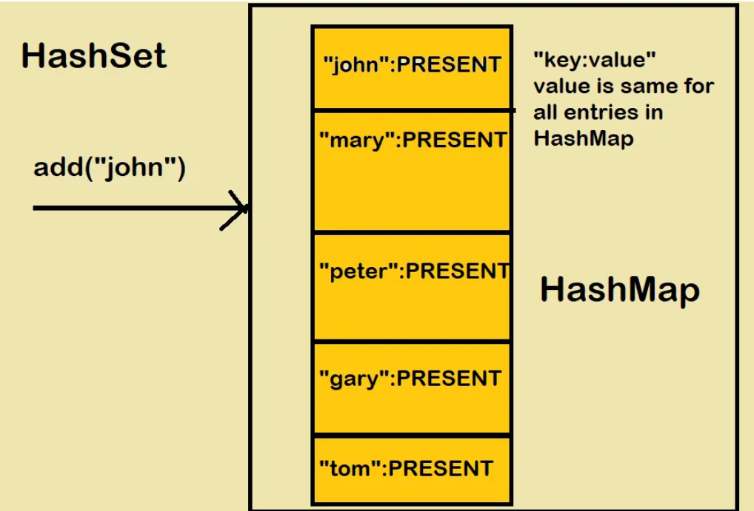
HashSet
Hashing – Technique to convert data into unique hashcode for efficient storage and access
HashSet uses hashing to store unique element to provide fast lookups
add(),remove(), contains() run on O(1)
Does not maintain insertion order
When to Use: Fast Lookup and Membership Checking: Checking unique user IDs in a system

Slide 73
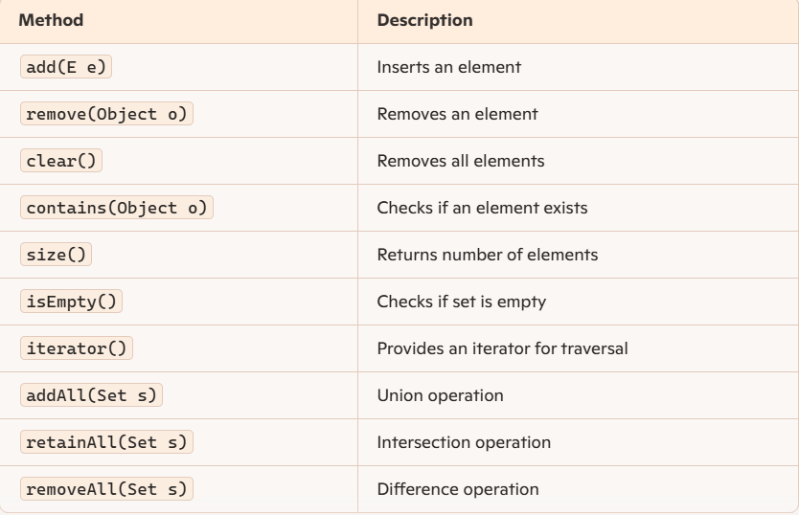
HashSet Methods

Slide 74
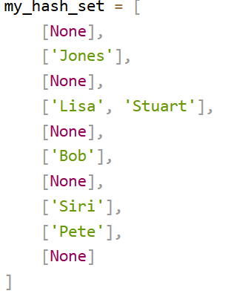
Handling Collisions in HashSet
Chaining - give room for more elements with same Hashcode by implementing each bucket as a linked list, or as an array.
Linear Probing – Find the next bucket to insert the duplicate data

Slide 75
LinkedHashSet
a combination of HashSet and LinkedList
Contains unique elements
maintains insertion order
Uses Hashing + Linked List to provide fast lookups (O(1)) like HashSet and maintains order like LinkedList

Slide 76
TreeSet
Sorted Order - Stores elements in natural ascending order (1, 2, 3... or A, B, C...)
No Duplicates Allowed → Ensures uniqueness of elements
balanced binary search tree - ensuring logarithmic time (O(log n)) for operations.
Provides methods for range-based queries (higher(), lower(), subSet())

Slide 77
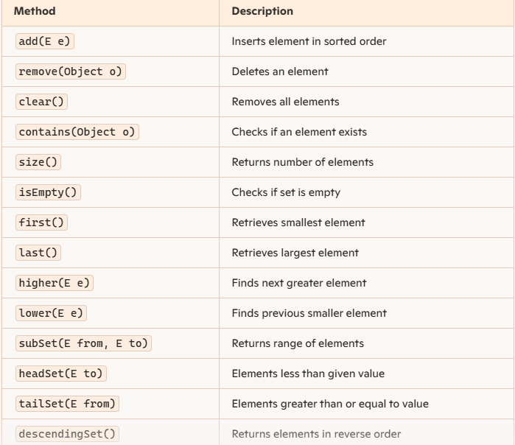
TreeSet Methods

Slide 78
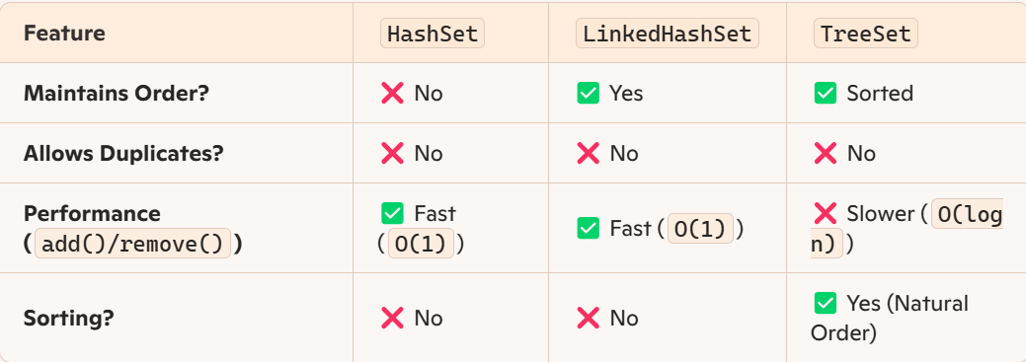

Slide 79
HashMap
Stores key-value pairs - Each key maps to a unique value
No duplicate keys allowed - instead overwrites the previous value
One Null Key and multiple Null values
hashing for fast retrieval (O(1)) - Operations like get(), put(), and remove() are efficient
Collisions handled by chaining with linkedlists
Not Synchronized

Slide 80
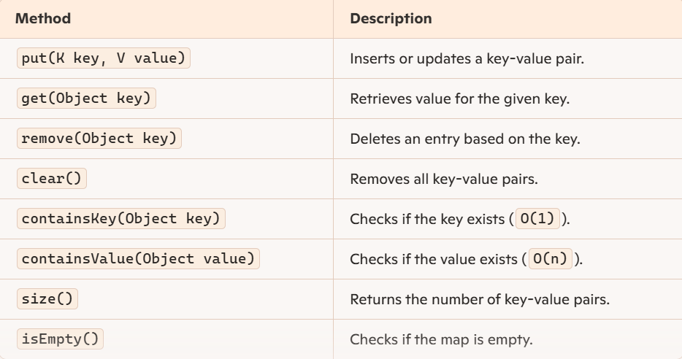
HashMap Methods

Slide 81
LinkedHashMap
Combination of hashing (from HashMap) and linked list ordering (like LinkedHashSet)
maintains insertion order while allowing fast retrieval (O(1))

Slide 82
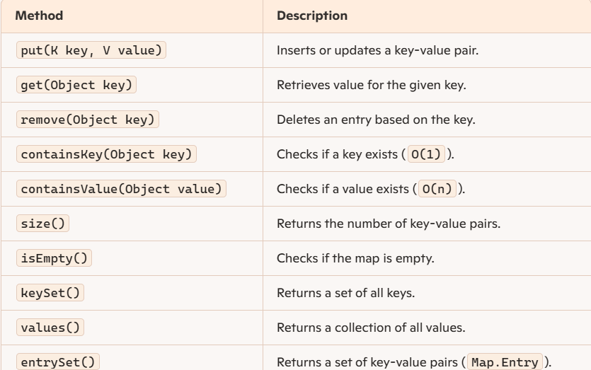
LinkedHashMap Methods

Slide 83
TreeMap
Stores key-value pairs in a sorted order (by keys)
Implemented as a red-black binary search tree
Provides logarithmic-time performance (O(log n)) for basic operations
Does not allow null keys

Slide 84
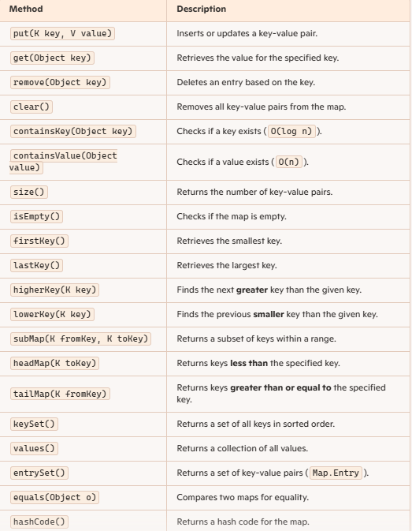
TreeMap Methods

Slide 85
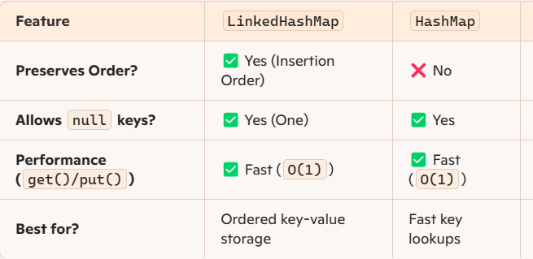

Slide 86
HashTable
implements the Map interface to store key-value pairs
Similar to HashMap, but it is synchronized - thread-safe
Legacy Class - Introduced before HashMap, but ConcurrentHashMap is preferred now

Slide 87
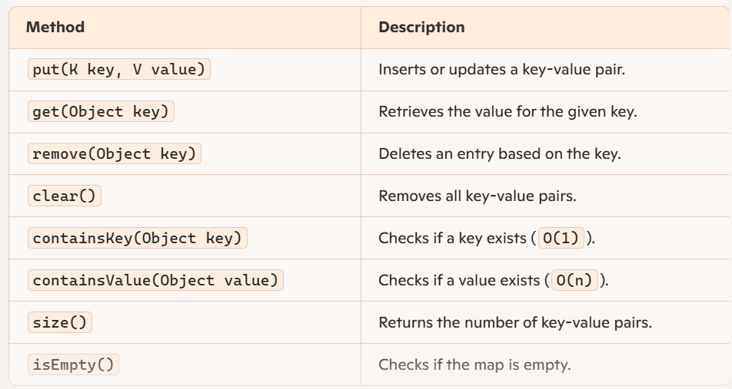
HashTable Methods

Slide 88


Slide 89
Iterator
interface to traverse elements in a collection one-by-one regardless of its internal structure
Supports Removal - Can remove elements dynamically during iteration
Unidirectional Traversal - Moves only forward through the collection
used with lists, sets, queues, and maps

Slide 90

Iterator Methods

Slide 91
ListIterator
advanced iterator - traverses lists in both forward and backward directions
1
Extends Iterator, but implements List – only can be used on List classes
2
Allows element modification – can add, remove, or update elements while iterating
3

Slide 92

ListIterator Methods

Slide 93

Comparable Interface
interface in Java is used for natural ordering of objects
comparison based on a single attribute
Only one sorting logic per class
Works with Collections.sort() and Arrays.sort()

Slide 94
Comparator Interface
interface in Java to define custom sorting logic for objects
allows you to sort objects in multiple ways
can define different comparators for sorting
Sorting logic is defined outside the class
Useful when sorting existing classes that cannot be modified

Slide 95


Slide 96

Threads in Java
Lightweight subprocesses, representing the smallest unit of execution with separate paths
Multiple threads can be used at a time, increasing efficiency
Handled by JVM
Can be created by :
Extending Thread Class
Implementing Runnable Interface

Slide 97


Thread Lifecycle

Slide 98

Thread vs Process

Slide 99


Slide 100
Threads Implementation
Extending class with Threads:
01
Simple and straightforward for basic threading
Does not work on child classes – no multiple inheritance
Implementing with Runnable Interface:
02
Allows to extend to other classes – flexible
Useful when the task to be executed by the thread is already part of a class hierarchy

Slide 101

File Handling
built-in classes in the java.io and java.nio packages
allows programs to read, write, and manipulate files on the system
built-in classes in the java.io and java.nio packages

Slide 102
FileReader and FileWriter
used for reading and writing character files. reads data character by character
basic classes and methods suitable for simple text file operations
does not support buffering

Slide 103

FileReader Methods

Slide 104

FileWriter Methods

Slide 105
BufferedReader and BufferedWriter
Buffering – reads and writes a larger chunk of data at once and stores it in memory, improves performance
readLine() - reads a line of text at a time, making it convenient for processing text files
newLine() - writes a platform-independent newline character

Slide 106

BufferedReader Methods

Slide 107

BufferedWriter Methods

Slide 108
The File Class
used to create, delete, and manage file system objects, files and directories
Works with absolute and relative paths
Used with FileReader, FileWriter, BufferedReader, etc.

Slide 109

File Class Methods

Slide 110

FileInputStream & FileOutputStream
used for handling binary data in files
Reads and writes on images, videos, and audio files

Slide 111

FileInputStream Methods

Slide 112

FileOutputStream Methods

Slide 113


Slide 114
Java Data Base Connectivity (JDBC)
API that helps applications to communicate with databases
Enables execution of SQL queries in Java programs
Works with multiple databases: MySQL, PostgreSQL, Oracle, etc.
Supports CRUD operations (Create, Read, Update, Delete)
Facilitates dynamic query execution

Slide 115

JDBC Architecture
Application: Java application that communicates with a data source
The JDBC API: Allows Java programs to execute SQL queries and get results from the database. Contains:
Interfaces like Driver, ResultSet, RowSet, PreparedStatement, and Connection that helps managing different database tasks.
Classes like DriverManager, Types, Blob, and Clob that helps managing database connection
DriverManager: uses database-specific drivers to effectively connect enterprise applications to databases
JDBC drivers: handle interactions between the application and the databases
Classes like DriverManager, Types, Blob, and Clob that helps managing database connections

Slide 116


Two Tier vs Three Tier Architecture

Slide 117

Types of JDBC Drivers
Type 1 – JDBC-ODBC Bridge Driver (Legacy, slow, not recommended)
Type 2 – Native API Driver (Vendor-specific, requires native libraries)
Type 3 – Network Protocol Driver (Intermediate server, used in web applications)
Type 4 – Thin Driver (Pure Java) (Most efficient, used in modern apps)

Slide 118

JDBC Classes and interfaces

Slide 119
JDBC Statements –Statement Interface
used for general-purpose access to databases for executing static SQL statements at runtime
Methods:
execute(String SQL): used to execute any SQL statements (like SELECT, INSERT, UPDATE or DELETE). If the ResultSet object is retrieved, then it returns true else false is returned.
executeUpdate(String SQL): used to executes SQL statements (like INSERT, UPDATE or DELETE). It returns the number of rows affected by the SQL statement.
ResultSet executeQuery(String SQL): It is used to executes the SELECT query. It returns a ResultSet object that contains the data retrieved by the query.

Slide 120
Prepared Statement
represents a precompiled SQL statement that can be executed multiple times
accepts parameterized SQL queries, with ? as placeholders for parameters, which can be set dynamically
Methods:
execute() :This returns a boolean value and executes a static SQL statement that is present in the prepared statement object.
executeQuery(): This returns a ResultSet from the current prepared statement.
executeUpdate(): This returns the number of rows affected by the DML statements such as INSERT, DELETE, and more that is present in the current Prepared Statement.

Slide 121
Callable Statement
used to execute stored procedures in the database
useful for executing complex operations that involve multiple SQL statements
Methods:
execute(): Executes the stored procedure and returns a boolean indicating whether the result is a ResultSet (true) or an update count (false).
executeQuery(): Executes a stored procedure that returns a ResultSet.
executeUpdate(): Executes a stored procedure that performs an update and returns the number of rows affected

Slide 122


Slide 123

JDBC Transactions
Transaction are control methods to ensure data consistency and allow handling of multiple SQL operations as a single unit
commit, rollback and savepoints

Slide 124

Java 8 Features
Introduction of new significant features, primarily focused on functional programming and enhanced API capabilities
support for functional programming, new Java 8 APIs, a new JavaScript engine, new Java 8 streaming API, functional interfaces, default methods, date-time API changes, etc.

Slide 125


Slide 126

Functional Interfaces
interface that contains only one abstract method
can have multiple default or static methods, but only one abstract method
Can be used with lambda expressions
Annotation @FunctionalInterface

Slide 127
Built-in Functional Interfaces in Java
Runnable: This interface only contains the run() method.
Comparable: This interface only contains the compareTo() method.
ActionListener: This interface only contains the actionPerformed() method.
Callable: This interface only contains the call() method.

Slide 128

Types of Functional Interfaces - Consumer
accepts only one, has no return value
Consumer<Integer> consumer = (value) -> System.out.println(value);
Use accept() to call
Chaining using andThen() method

Slide 129

Types of Functional Interfaces - Predicate
represents a boolean-valued function of one argument, commonly used for filtering operations in streams
Use test() to call
Syntax: Predicate predicate = (value) -> value != null;

Slide 130
Types of Functional Interfaces - Function
receives only a single argument and returns a value after the required processing
Function<Integer, Integer> function = (value) -> value * value;
Bi-Function: related to a Function, takes two arguments, whereas Function accepts one argument. Uses apply() to call
Unary Operator and Binary Operator: both extend the Function and Bi-Function respectively, where both the input type and the output type are same. Uses apply() to call

Slide 131
Types of Functional Interfaces - Supplier
does not take any input or argument and yet returns a single output
Commonly used for object creation, random number generation
Supplier<String> supplier = () -> "Hello, World!";
Uses get() method to call

Slide 132

Lambda Expressions
represents the instances of functional interfaces (interfaces with a single abstract method)
provide a concise way to express instances of single-method interfaces using a block of code
Code as Data: Treat functionality as a method argument
Class Independence: Create functions without defining a class
Pass and Execute: Pass lambda expressions as objects and execute on demand

Slide 133
Types of Lambda Expressions
Lambda with Zero Parameter
() -> System.out.println("Zero parameter lambda");
Lambda with Single Parameter
(p) -> System.out.println("One parameter: " + p);
Lambda with Multiple Parameters
(p1, p2) -> System.out.println("Multiple parameters: " + p1 + ", " + p2);

Slide 134

Streams in Java
sequence of objects that supports various methods that can be pipelined to produce the desired result
perform operations like filtering, mapping, reducing, and sorting
takes input from the Collections, Arrays, or I/O channels, provide the result as per the pipelined methods

Slide 135

Types of Operations in Streams
Intermediate Operations : transform a stream into another stream
enables the concept of filtering where one method filters data and passes it to another method after processing

Slide 136

Stream methods – Intermediate Operations

Slide 137

Streams filter() method
filter(Predicate<T>) allows filtering elements based on a specified condition
removes elements that do not satisfy the condition
Syntax : stream.filter(condition);

Slide 138

Streams map method
map(Function<T, R>) is used to transform each element of a stream by applying a given function
used for converting data types, modifying values, or extracting specific fields
Syntax: stream.map(transformation);

Slide 139

Streams Terminal Methods
type of Operations that return the result
These Operations are not processed further just return a final result value

Slide 140

Stream methods – Terminal Operations

Slide 141

Streams collect() method
used as a terminal operation to accumulate elements into a collection or perform reduction operations
Syntax: stream.collect(Collector.toCollection());

Slide 142

Streams reduce() method
reduce() method in the Java Streams API is a terminal operation that aggregates stream elements into a single result using a binary function
Used for summation, multiplication, concatenation, and other operations
Syntax: T result = stream.reduce(initialValue, (accumulator, element) -> operation);

Slide 143

Streams forEach() Method
used as a terminal operation to iterate over each element in a stream and perform an action using a Consumer functional interface
Syntax: stream.forEach(action);

Slide 144

Optional Classes
Optional<T> class in Java helps in handling null values safely, preventing NullPointerExceptions
helps in writing a neat code without using too many null checks
Provides methods for handling missing values safely
Supports functional programming with map(), filter(), and orElse()

Slide 145


Optional Class Methods - Creation

Slide 146

Optional Class Methods – Value Presence

Slide 147


Optional Class Methods – Value Fetch

Slide 148


Optional Class Methods – Transform

Slide 149

Generics in Java
allow types to be parameterized, making code type-safe, reusable, and flexible
eliminate the need for manual type casting ,prevents ClassCastException
Enables performing type checks at compile time
Works with Collections

Slide 150

How Generics work
Uses type parameters, which are placeholders for actual types
Creating an instance of a generic class or calling a generic method allows to specify the actual type to be used

Slide 151

Generics Implementation – Generics Classes
class that Java allows type parameters (<T>) to be specified at the time of instantiation
makes the class flexible, reusable, and type-safe
Works with different data types dynamically

Slide 152

Generic Classes with Multiple Parameters

Slide 153

Generic Classes with Bounded Parameters

Slide 154

Generics Implementation - Generic Method
allows a method to accept different types of parameters
define a generic method by placing the type parameter(s) before the method’s return type
Example: public static <E> void printArray(E[] inputArray)

Slide 155

Wildcards
(?) in Java Generics provide flexibility when working with generic types
allows methods and classes to accept unknown or varying types dynamically

Slide 156

Types of Wildcards

Slide 157

Difference between type Parameters and Wildcards

Slide 158

Annotations
metadata tags that provide additional information about the code without affecting its execution
used for compiler instructions, runtime processing, and code documentation
Helps in automated processing (e.g., serialization, testing frameworks)

Slide 159

Built –In Annotations

Slide 160
Types of Annotations
Marker Annotations: mark a declaration; do not consist of any data; its presence as an annotation is sufficient. Ex: @Override
Single value Annotations: contain only one member and allow a shorthand form of specifying the value of the member. Ex:@TestAnnotation(“testing”);
Full Annotations: Consists of multiple data members, names, values, pairs.
Ex: @TestAnnotation(owner=”Rahul”, value=”Class Geeks”)
Type Annotations: applied to any place where a type is being used. declared annotated with @Target annotation.
Repeating Annotations: applied to a single item more than once. must be annotated with the @Repeatable annotation

Slide 161

Meta Annotations – Annotations to define Annotations

Slide 162

Custom Annotations
User Defined Annotaions
Can define their own metadata for methods, classes, and fields
created using @interface, followed by meta-annotations

Slide 163

Design Patterns in Java
Design patterns in Java are reusable solutions to common programming problems
Creational : manage object creation, ensuring flexibility and efficiency
Structural : simplify relationships between objects, ensuring flexibility
Behavioural : define communication between objects, improving flexibility

Slide 164

Singleton Design Pattern

Slide 165

Singleton Design Pattern
ensures a class only has one instance and provides a global point of access to it.
ensures that only one instance of the class exists throughout the application.
Restrict direct instantiation by making the constructor private, forcing the use of the access point

Slide 166

Factory Design Pattern

Slide 167

Factory Design Pattern
Provides an interface to create objects in a superclass, allowing subclasses to alter the type of objects that will be created
simplifies the object creation process by placing it in a dedicated method, promoting loose coupling between the object creator and the objects themselves

Slide 168

Observer Design Pattern
defines a one-to-many dependency between objects
deals with the interaction and communication between objects, specifically focusing on how objects behave in response to changes in the state of other objects

Slide 169


Slide 170

Strategy Design Pattern
allows selecting an algorithm dynamically at runtime.
decouples algorithms from the class using them, enabling flexibility
Useful when you want to dynamically change the behaviours of a class without modifying its code

